Slide 1
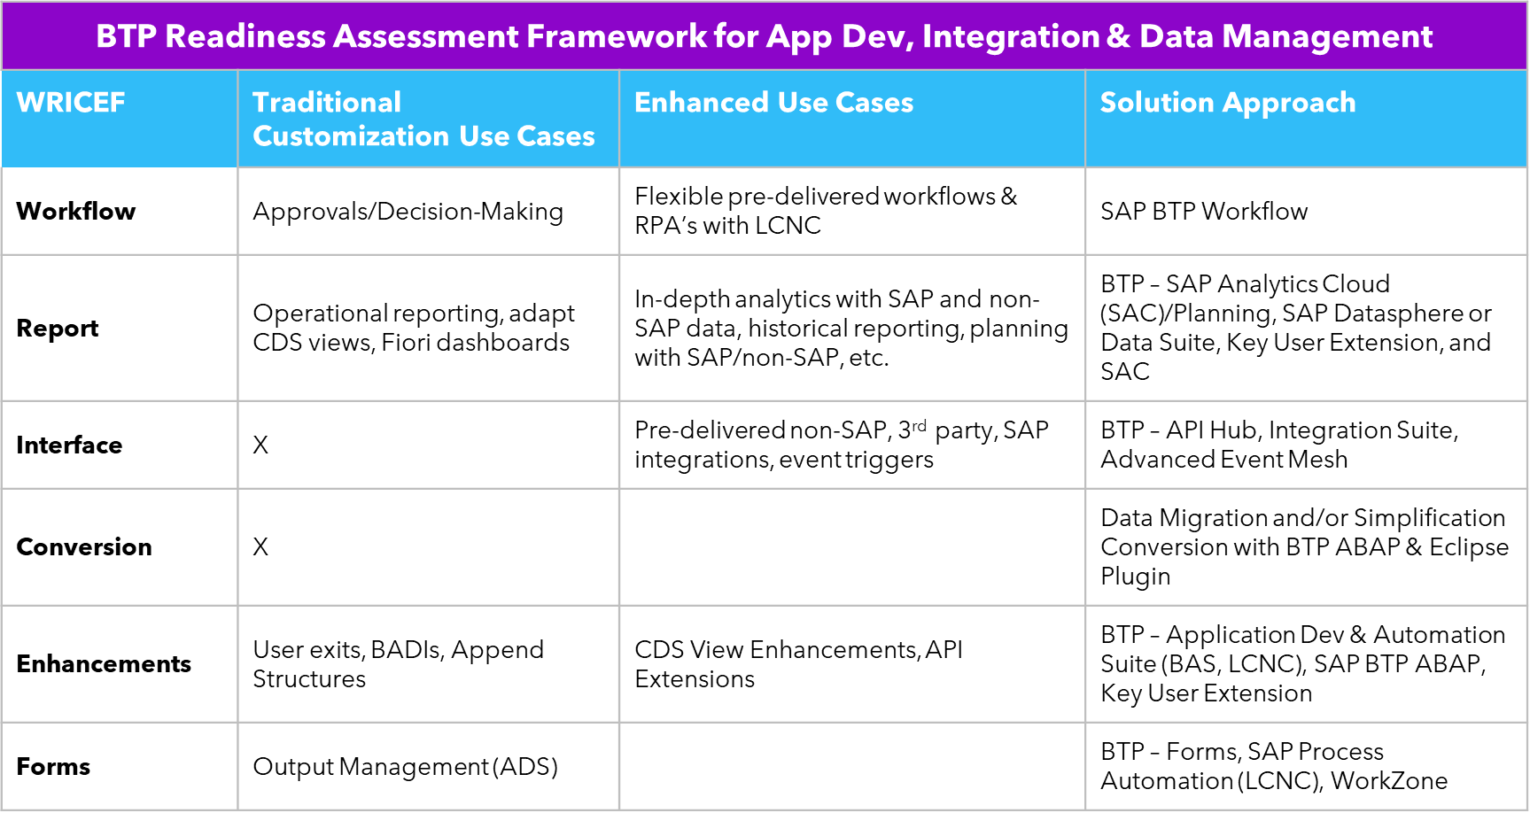
ACHIEVE RAPID
CLEANCORE CODE READINESS
Regardless of your current ERP landscape, SAP’s Business Technology Platform (BTP) helps you gain key cloud advantages at the Use Case level across Lines of Business. Using BTP, you’ll enhance, accelerate, automate, and simplify core business processes in the cloud while minimizing cost, time, and risk.
To become BTP ready, you’ll need to assess and tweak code assets so that they comport with BTP’s CleanCore requirement.
The InFocus Code Readiness Assessment, a Sierra exclusive, is a remotely-administered system scan that prescribes for you what to do, in what order, when, and how in order to stage your CleanCore transformation.
The Assessment consists of a 5-day, deep dive into your existing code environment and future state ambitions. Running from ABAP Cloud on BTP, the Assessment delivers:
Overview of As-Is and To-Be Architecture
WRICEF System Scan: Inventory of Migration Objects
How each customization will manifest in BTP
C3 Assessment Report
Natural language, AI-powered insights from SAP’s Virtual GenAI Assistant
© 2023 Sierra Digital, Inc. All rights reserved.

